Slide 1
REMOTE SENSING · MONSOON AGRICULTURE · SYLHET, BANGLADESH
The Limits of Optical Crop Monitoring
Quantifying Monsoon Observation Gaps in Sylhet Rice Systems
A Sentinel-2 / Google Earth Engine analysis of Transplanted Aman (T. Aman) rice monitoring, 2022–2024
126
37.30%
55–90
Study Area:
Dakshin Surma, Sylhet Sadar
acquisition
opportunities
overall observation
availability
day maximum
observation gaps

Slide 2
EXECUTIVE SUMMARY
Cloud contamination sharply limits usable optical observations
Across three consecutive Aman cycles (2022–2024), a Google Earth Engine pipeline combining s2cloudless and cloud-shadow detection evaluated 126 Sentinel-2 acquisition opportunities over a 15.10 km² non-haor T. Aman rice plain. At the primary 50% clear-cropland validity threshold, only 37.30% of acquisitions qualified as valid observations — leaving gaps of up to 55–90 days within a single growing season.
126
37.30%
55 days
90 days
Acquisition opportunities
analyzed (2022–24)
Overall observation
availability at 50% threshold
Maximum within-season gap
(Jun 5 – Jul 30, 2023)
Maximum gap at the
strict 90% threshold
KEY TAKEAWAY
Low availability does not manifest as uniform thinning of the record — it clusters into a small number of severe gaps. This distinction matters more than the headline percentage for any downstream interpolation or fusion strategy.
Sylhet T. Aman Optical Monitoring Gap Study | 2022–2024
2

Slide 3
INTRODUCTION
Acquisition frequency is not the same as usable observation frequency
Sentinel-2 imagery and NDVI are foundational tools for agricultural monitoring, but their efficacy is constrained by atmospheric conditions. In Bangladesh, persistent monsoon cloud cover necessitates rigorous cloud masking — which removes contaminated pixels but creates temporal “data voids” that are frequently filled by interpolation or smoothing.
WHY THIS MATTERS
Cloud-prone South Asian rice landscapes have historically pushed operational mapping toward radar (SAR) alternatives.
This study evaluates availability using a cropland-aware clear-surface criterion — not just scene-level cloud metadata.
The distinction between acquisition and spatially sufficient clear observation is central to interpreting any optical NDVI time series.
RESEARCH QUESTION
How does monsoon-period cloud and shadow contamination affect the temporal availability and reliability of Sentinel-2 observations for NDVI-based rice monitoring in Sylhet?
Sylhet T. Aman Optical Monitoring Gap Study | 2022–2024
3

Slide 4
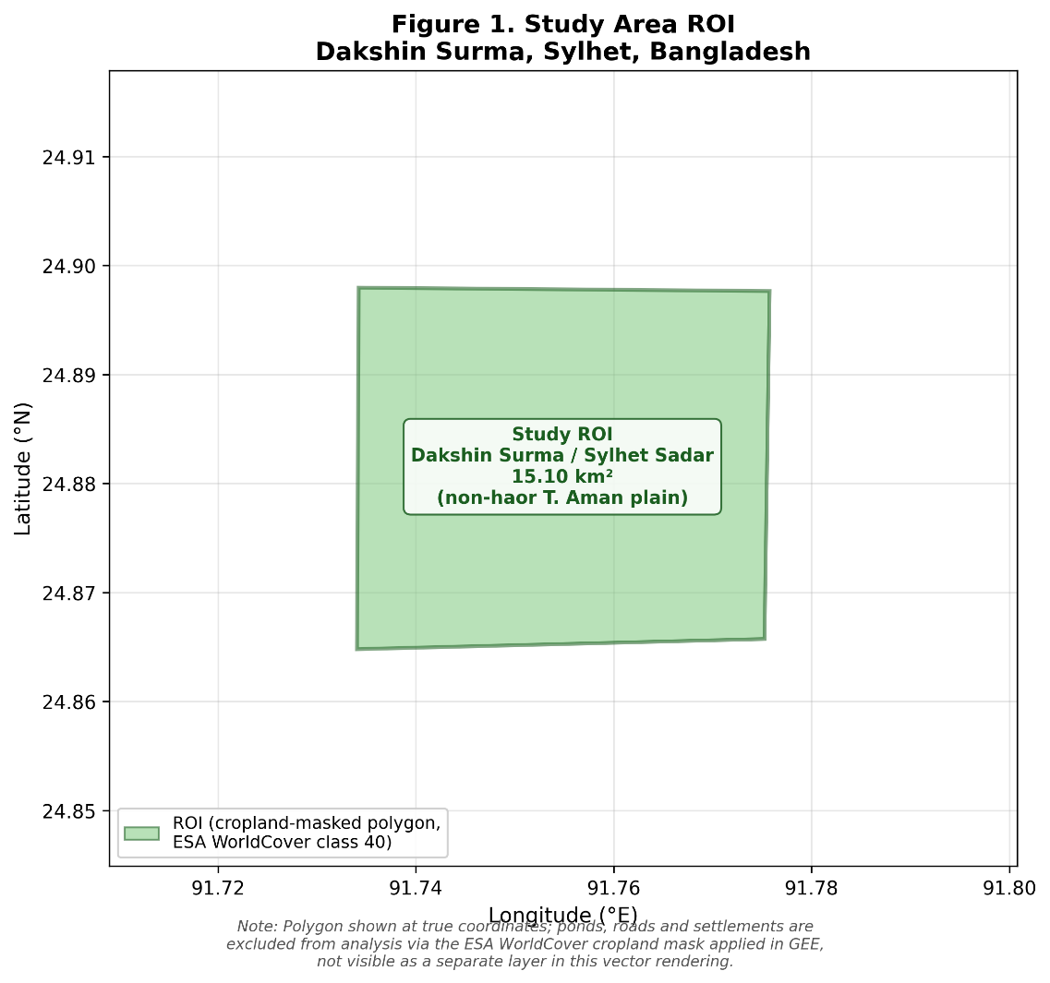
METHODOLOGY — STUDY AREA
A 15.10 km² non-haor T. Aman plain in Dakshin Surma, Sylhet
LOCATION
Dakshin Surma / Sylhet Sadar, Sylhet, Bangladesh
AREA
15.10 km² cropland-masked ROI (ESA WorldCover class 40)
EXCLUSION
Haor regions excluded — avoids confounding cloud gaps with seasonal submergence
MONITORING WINDOW
June 1 – December 31, spanning three Aman seasons: 2022, 2023, 2024
SCOPE NOTE
Study does not independently verify field-level phenological stages within the ROI
Sylhet T. Aman Optical Monitoring Gap Study | 2022–2024
4

Slide 5
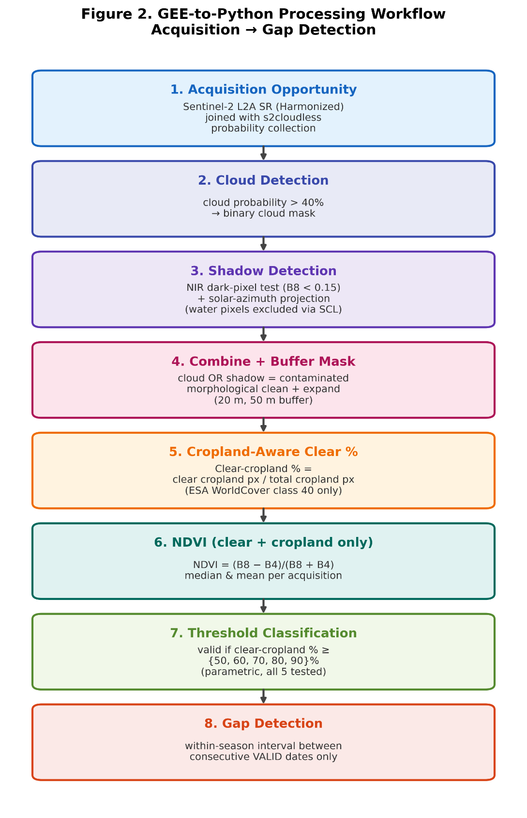
METHODOLOGY — DATA & PIPELINE
An 8-stage GEE-to-Python pipeline: acquisition to gap detection
DATA SOURCE
Sentinel-2 Level-2A Surface Reflectance (Harmonized), 2022–2024, ensuring consistent dual-satellite coverage from Sentinel-2A and 2B/2C — a nominal 5-day revisit at the equator, better at Sylhet’s mid-latitude.
KEY PROCESSING PARAMETERS
Cloud probability threshold
40%
NIR dark-pixel threshold
0.15
Cropland definition
ESA WorldCover class 40
Resolution / alignment
10 m, aligned to Sentinel-2 B4 (Red)
Nominal revisit describes acquisition frequency, not usable-observation frequency: cloudiness is spatially and seasonally structured, not randomly distributed.
Sylhet T. Aman Optical Monitoring Gap Study | 2022–2024
5

Slide 6
METHODOLOGY — DEFINITIONS
Six terms that structure the analysis
1
Acquisition opportunity
2
Valid observation
A Sentinel-2 image available for the ROI.
An acquisition where clear-cropland % ≥ the selected threshold.
3
Invalid acquisition
4
Temporal observation gap
An acquisition where clear-cropland % < the selected threshold.
The interval between two consecutive valid observation dates within the same Aman season.
5
Raw NDVI availability
6
Threshold-based invalidity
NDVI median is null when clear-cropland % = 0% — no usable pixels existed for that acquisition.
The acquisition has an NDVI estimate but fails the selected clear-cropland validity criterion.
Sylhet T. Aman Optical Monitoring Gap Study | 2022–2024
6

Slide 7
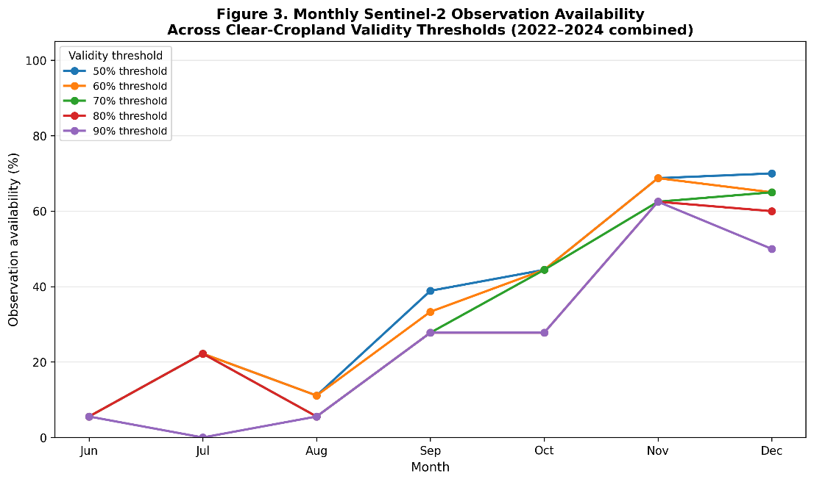
RESULTS — GENERAL AVAILABILITY
Only 37.30% of acquisitions cleared the primary validity threshold
Of 126 total acquisition opportunities identified across the three-year study period, just 47 were classified as valid observations at the primary 50% clear-cropland threshold — and availability was far from evenly spread across the season.
126
Total acquisition
opportunities
47
Valid observations
(≥ 50% threshold)
37.30%
Overall
availability
Sylhet T. Aman Optical Monitoring Gap Study | 2022–2024
7

Slide 8
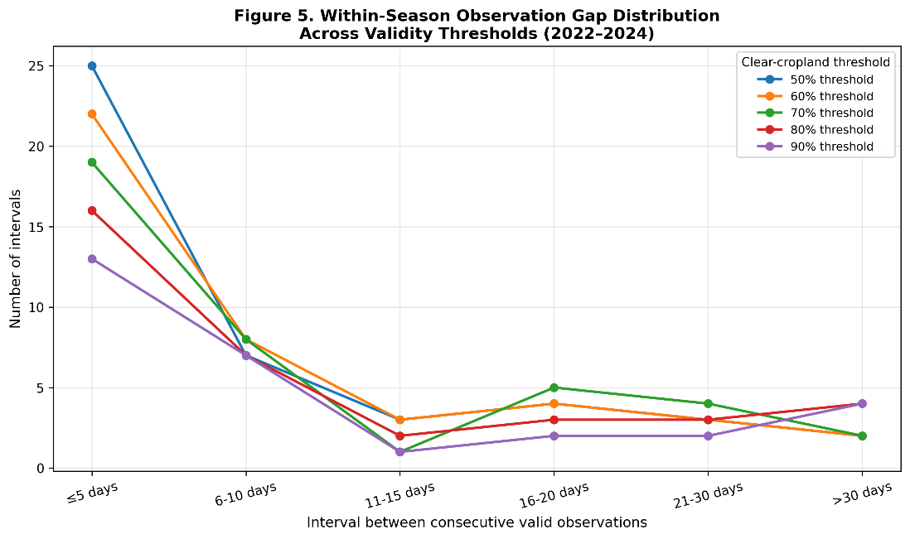
RESULTS — TEMPORAL GAP ANALYSIS
A 55-day blackout struck at the start of the 2023 monsoon
The longest temporal gap identified — 55 days, between June 5 and July 30, 2023 — falls during the early Aman window, when fine-scale temporal interpretation is hardest without direct optical evidence. This is a pooled maximum across all three seasons (see Limitations).
55 DAYS WITHOUT A VALID OBSERVATION
Jun 5, 2023
Jul 30, 2023
Jun
Jul
Aug
Sep
Oct
Nov
Dec
Most within-season intervals fall under 10 days — but a persistent tail of intervals exceeding 16–30+ days recurs across every threshold.
Gap distribution across
validity thresholds
Sylhet T. Aman Optical Monitoring Gap Study | 2022–2024
8

Slide 9
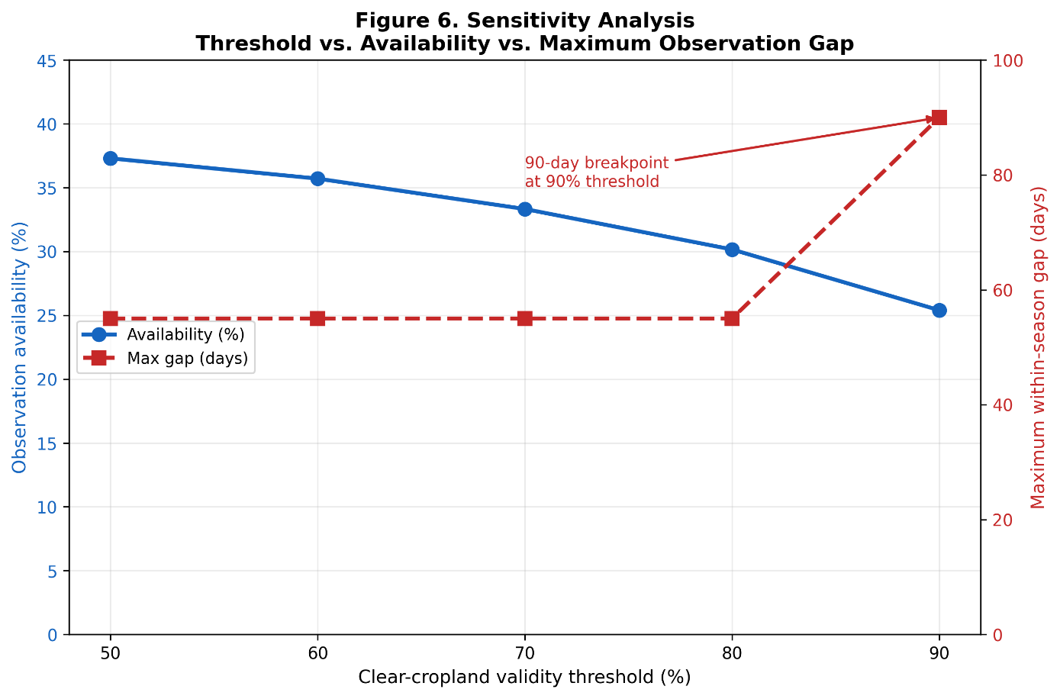
RESULTS — THRESHOLD SENSITIVITY
Stricter quality criteria trigger a sharp jump in maximum gap length
The maximum within-season gap held steady at 55 days from the 50% through 80% thresholds — but expanded to 90 days at the 90% threshold, as previously continuity-preserving observations were removed and shorter intervals merged into one long gap.
THE 90-DAY BREAKPOINT
At the 90% threshold, availability falls to 25.40% and the maximum gap widens to 90 days — spanning June 5 to September 3, 2023.
This 90-day interval represents a substantial share of the entire monitoring window — a critical constraint for any reconstruction relying on the strictest quality bar.
Sylhet T. Aman Optical Monitoring Gap Study | 2022–2024
9

Slide 10
RESULTS — MISSING DATA CONSISTENCY
Tracing all 126 acquisitions from raw NDVI to threshold validity
NDVI median is null exactly when clear-cropland % = 0%. Of 68 acquisitions with a computable NDVI, only 47 additionally met the 50% clear-cropland validity bar — reconciling to 79 invalid acquisitions overall (58 null + 21 below threshold).
126
Total acquisitions
58 null
(0% clear-cropland)
68
NDVI median available (clear-cropland % > 0%)
21 below threshold
(0% < clear-cropland < 50%)
47
Valid observations (clear-cropland % ≥ 50%)
TABLE 1 — RECONCILIATION OF NDVI AVAILABILITY AND THRESHOLD-BASED VALIDITY (n = 126)
Category | Number
Total acquisitions | 126
NDVI median available (clear-cropland % > 0%) | 68
NDVI median null (clear-cropland % = 0%) | 58
Valid observations (clear-cropland % ≥ 50%) | 47
Invalid acquisitions (clear-cropland % < 50%) | 79
Sylhet T. Aman Optical Monitoring Gap Study | 2022–2024
10

Slide 11
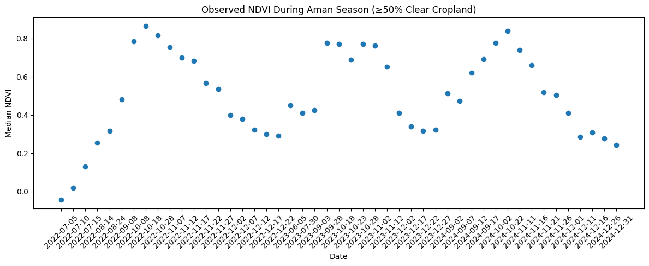
RESULTS — DIRECTLY OBSERVED NDVI
The record that remains: direct NDVI observations, no interpolation
Points represent acquisitions satisfying the 50% clear-cropland validity criterion; no smoothing or interpolation has been applied between them. The visible clustering and blank intervals are the direct signature of the observation gaps quantified in this study.
Sylhet T. Aman Optical Monitoring Gap Study | 2022–2024
11

Slide 12
DISCUSSION
Sparse observations cluster — they don’t thin out evenly
The clustering effect
Implications for interpolation
Answering the research question
Overall availability summarizes how many acquisitions were usable, but not how they are distributed through time. The 55-day interval shows that relatively sparse usable observations can cluster in ways that create substantial periods without direct optical evidence.
Any continuous NDVI reconstruction across these gaps requires interpolation or smoothing rather than direct observation — particularly across the 55- and 90-day gaps identified here, where estimated values would dominate the record.
Monsoon cloud and shadow contamination substantially reduces Sentinel-2 temporal availability for NDVI-based rice monitoring in Sylhet — manifesting as a small number of severe, clustered gaps rather than uniform thinning of the record.
Sylhet T. Aman Optical Monitoring Gap Study | 2022–2024
12

Slide 13
DISCUSSION — REGIONAL CONTEXT
Is Sylhet unusually cloud-prone — or is this the regional norm?
Read in isolation, 37.3% availability could suggest an unusually cloud-prone site. The broader literature points instead to a general feature of monsoon-season optical remote sensing across South and Southeast Asia.
Global Sentinel-2 metadata
Tropics-wide Landsat / S2 studies
Established SAR practice
Cloud contamination is spatially and seasonally structured; acquisition frequency alone poorly predicts usable-scene frequency.
Multi-week to multi-month waits between cloud-free observations are reported across persistently cloudy regions, even with frequent nominal revisit.
Prior paddy-rice mapping across cloud-prone Bangladesh and Northeast India relied on Sentinel-1 SAR precisely because optical revisit could not deliver reliable clear-sky observations.
This study’s optical-only availability figures are best read as a quantitative case for the established SAR / optical–SAR fusion practice — showing, in numeric terms, the size of the gap such an approach would need to close for this study area.
Sylhet T. Aman Optical Monitoring Gap Study | 2022–2024
13

Slide 14
SCIENTIFIC WEAKNESSES & LIMITATIONS
Six limitations to weigh when interpreting these results
1
Detected “gaps” are artifacts of the selected masking procedure and thresholds — not proof of zero usable sensor information.
2
Biological interpretation is constrained by a lack of independent ground-truth farming calendars for the specific ROI.
3
Cloud masking parameters involve inherent trade-offs between commission and omission errors.
4
Results are seasonally and ROI-specific; they may not represent annual monsoon behavior outside the Aman agricultural context.
5
The study is restricted to optical data and does not incorporate SAR alternatives, which are less affected by cloud cover.
6
The 55- and 90-day maximum gaps are pooled across three seasons — a year-by-year decomposition has not yet been computed, so it is unclear whether 2023 is representative or an anomalous driver of the pooled maximum.
Sylhet T. Aman Optical Monitoring Gap Study | 2022–2024
14

Slide 15
CONCLUSION
An uncertainty-aware approach for cloud-prone NDVI monitoring
Cloud- and shadow-screening substantially reduced usable Sentinel-2 acquisitions in the Sylhet ROI. At the 50% clear-cropland criterion, only 37.3% of opportunities were valid, with a maximum within-season gap of 55 days — consistent with independent assessments of monsoon-tropics optical availability, reflecting a regional constraint rather than a site-specific anomaly. Agricultural monitoring systems should explicitly distinguish direct empirical observations from interpolated estimates when reconstructing vegetation trajectories in cloud-prone environments.
EVIDENCE TABLE — KEY MONITORING METRICS FOR SYLHET AMAN SEASONS (2022–2024)
Threshold | Valid Obs. (n) | Availability (%) | Max Gap (days) | Primary Gap Period | Δ vs. 50% (pp)
50% | 47 | 37.30 | 55 | Jun 5 – Jul 30, 2023 | Baseline
60% | 45 | 35.71 | 55 | Jun 5 – Jul 30, 2023 | −1.59
70% | 42 | 33.33 | 55 | Jun 5 – Jul 30, 2023 | −3.97
80% | 38 | 30.16 | 55 | Jun 5 – Jul 30, 2023 | −7.14
90% | 32 | 25.40 | 90 | Jun 5 – Sep 3, 2023 | −11.90
These findings support an uncertainty-aware approach to NDVI time-series analysis — distinguishing direct observations from temporally estimated values.
Sylhet T. Aman Optical Monitoring Gap Study | 2022–2024
15

